Slide 1
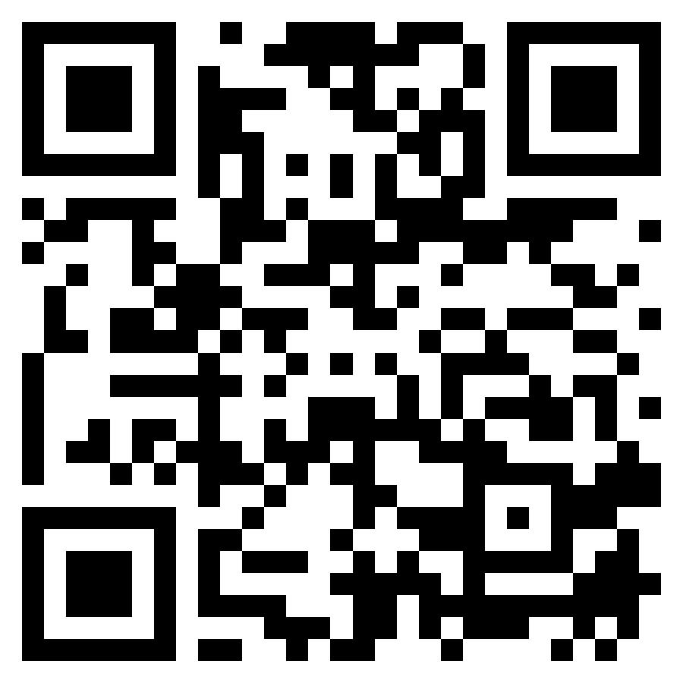
THE MINISTRY FOR YOU, LLC

Slide 2
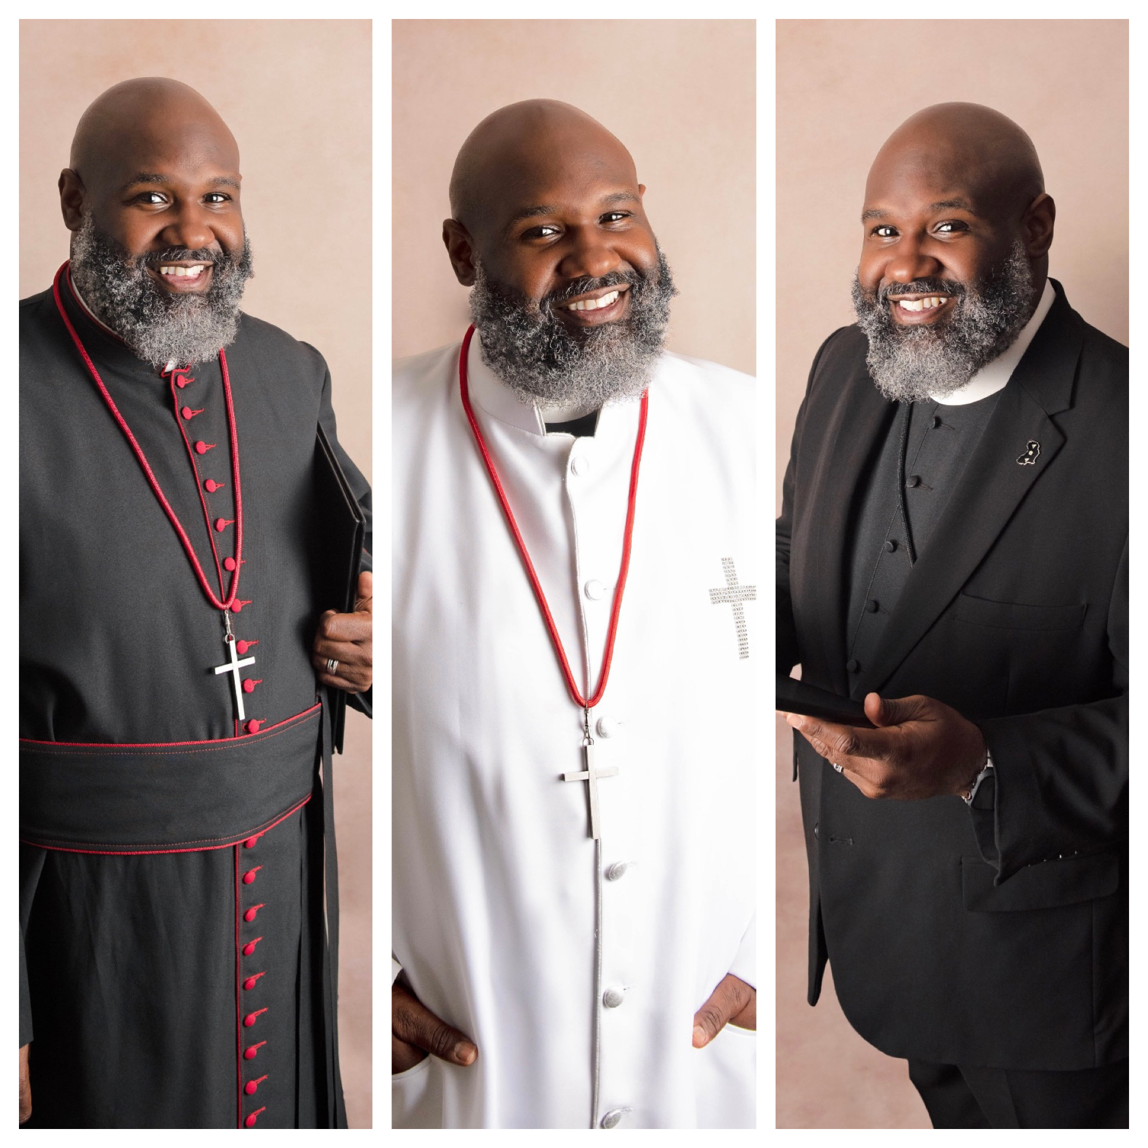
CREDENTIALS
American Association of Christian Counselors
Board Certified Pastoral Counselor - 2022
Faith Christian University & Schools
Master of Arts Christian Education – 2008
University of Delaware
Bachelor of Science, Human Services, Education & Public Policy - 2002
Licensed as Minister
Consecrated as Pastor
2009
2015
2012
2022
Ordained an Elder
Certified as Counselor
Notes:
Timeline

Slide 3
EXAMPLES OF TRADITIONAL VS. CONTEMPORARY CEREMONY STYLES
Traditional
The miracle of love is like the miracle of a flower. Its roots are secured in the memories of yesterday. It entwines itself around the heart. It thrives upon the sunshine of a smile and the joy of moments together. Bride and Groom, there are no connections on earth deeper than that which you are about to make. There are no vows more sincere than those you are about to say.
Contemporary
The most remarkable moment in life is when you meet the person who makes you feel complete. The person who makes the world a beautiful and magical place. The person with whom you share a bond so special that it transcends normal relationships and becomes something so pure and so wonderful, that you can’t imagine spending another day of your life without them. I know how deeply these two care for and love one another, and I feel privileged to be here today as a witness of their commitment to a lifetime of love for one another. In this union, we will celebrate the promises they will make to each other for respect, trust, comfort, joy, and love. Marriage is a promise of hope that endures all things.
Notes:
Traditional or Contemporary Ceremony

Slide 4
WEDDING STYLES
Civil Ceremony - very little mention of God
Religious Ceremony - inclusion of God and prayers
Interfaith Ceremony - bride and groom have different religious views

Slide 5
ETHNIC CEREMONY/TRADITIONAL OPTIONS
Jumping of the Broom
Libation Ceremony
Tasting of the Elements
Unity Candle
Sand Ceremony
Unity Water Ceremony
Tying of the Knot
Hand Tying
Notes:
Ethnic Options

Slide 6
RELIGIOUS OPTIONS
The Lord’s Prayer:
The minister can pray the prayer, the couple can pray the prayer, or everyone can pray. With either of the latter options, it can be said in unison or repeated after the minister.
Communion:
Christian couples, take communion to show that God is at the center of your marriage and fellowship together! This is something that you can do just between you and your bride or groom, or you can have your wedding party and/or guests take part as well!
Scripture:
I Corinthians 13:4-7
Ephesians 4:2-3
Ruth 1
1 Corinthians 16
I Peter 4
Notes:
Administrative Duties

Slide 7
VOW OPTIONS
Repeat
Compose
Combination
Bride and groom can repeat generic vows (traditional or contemporary) after the minister.
Bride and groom can compose vows spoken from their hearts and share them with one another during the ceremony.
Bride and groom can repeat the traditional, generic vows and share intimate vows during the ceremony.
Notes:
Vow Options

Slide 8
OFFICIANT ATTIRE
As the officiant, I dress in clergy attire and vestments that compliment your color scheme and design.
Robe (black or white)
Suit with shirt & tie (various colors)
Black suit with collared shirt (ministry vestment)
Notes:
Attire options (insert pics?)

Slide 9
PACKAGES
Bronze $275
Silver $399
Gold $699
Consultation
Filing with court
Consultation
Filing with court
Full Wedding Ceremony (50-mile travel distance)
Consultation
2 counseling sessions
Filing with court
Rehearsal
Full Wedding Ceremony (100-mile travel distance)
The final price will depend on the exact services performed by the officiant
*Ask about adding on additional services to a package

Slide 10
BOOKING STEPS
Visit webpage: www.theministryforyou.com.
Contact us via the button on the page, via phone or email.
Consultation with representative.
Review and sign contract.
Pay deposit.
Create and approve ceremony style and options.
Pay balance prior to wedding.

